Slide 1


Reviews Analysis
- BY Syed Almaas Parvez

Slide 2
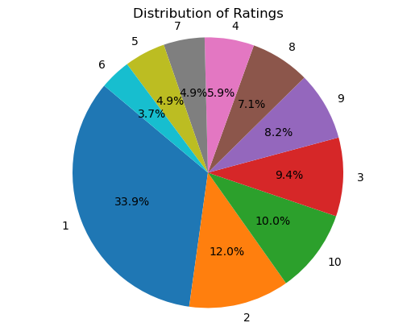
Percentage Distribution of 1000 Ratings
1 in 3 reviewers has given a rating of 1/10
1 in 10 has givern 10/10
More than 50% of ratings are not more than 3/10

Slide 3
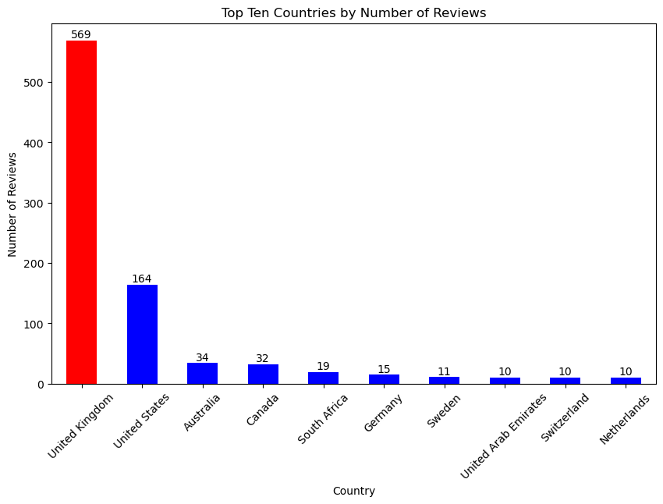
Top 10 Countries by Number of Reviews

Slide 4

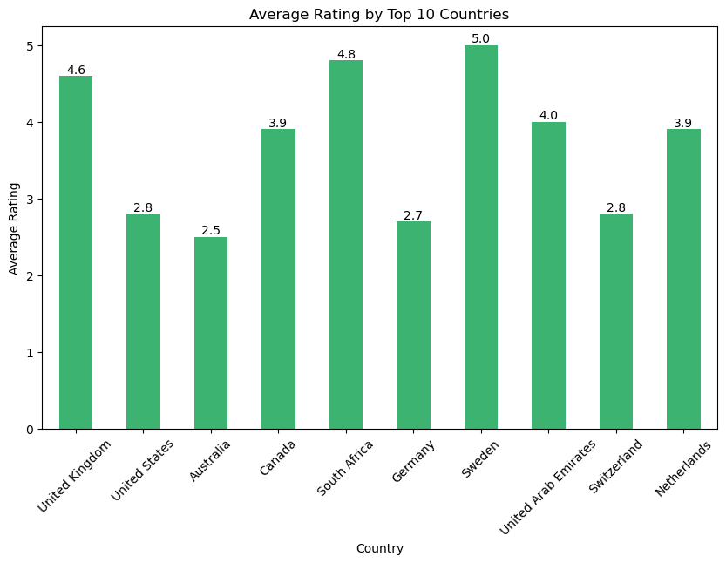



Australians gave the lowest average rating for British Airways,
while Swedish travellers gave a neutral rating

Slide 5
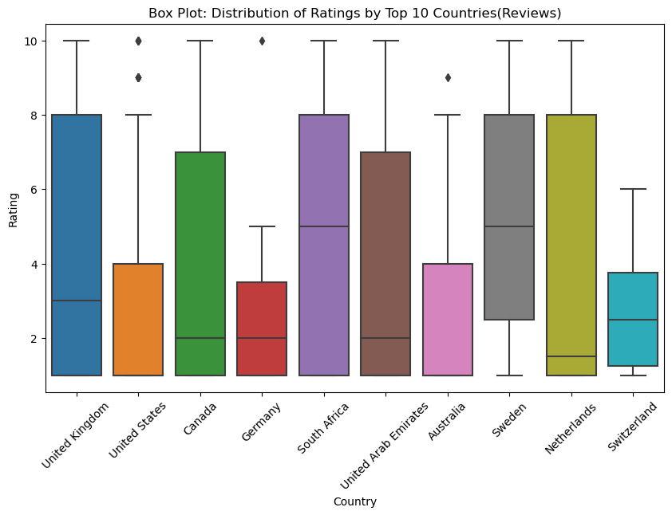
Ratings by citizens of UK is the most inconsistent and varies greatly

Slide 6
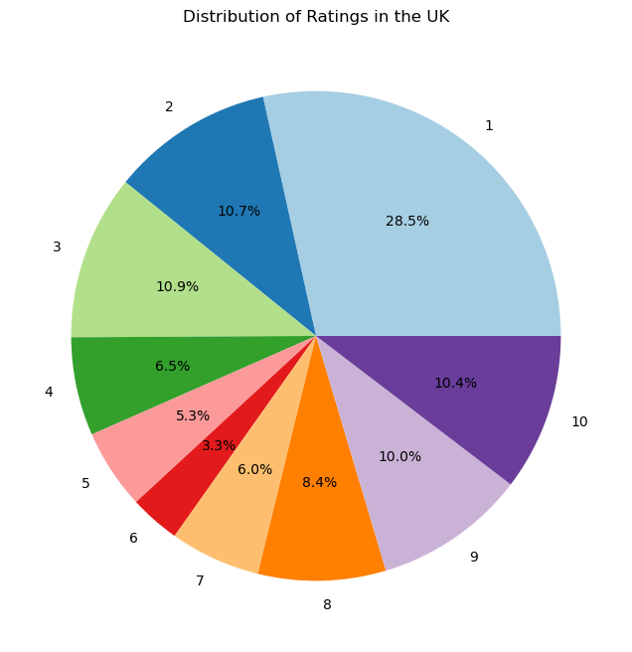
a quarter of travelers from UK is extremely dissatisfied by British Airways and gave a rating of just 1, while 1 in 10 gave it the highest rating of 10/10

